Slide 1

Git - Source control Management

Slide 2
Git
Agenda for today
!"#$%&'($
)$*+',- /,-&*,0 1-2 3/4
561& '+ 7'&8
91" :
7'& ;<-21=$-&10
91" >
7'& ?*1-%6'-@
91" A
91" B
7'& /,001",*1&',-
91" C
7'& 5,*DE,F
G<'H ,- 943

Slide 3

Objective
Key Learning achievement
After completion of this session you would be able to :
Install git and on any platform ( Windows, Mac, Linux etc)
Comfortably user git command for development work
Experiment with any public available git repository on any platform
Perform local development on open sourceproject
Submit developed feature for release in open source project
Understand and implement git workﬂow

Slide 4
Version Control System
A version control system is a software that tracks changes to a file or set of files over time so that you can recall specific versions later. It also allows you to work together with other programmers.
The version control system is a collection of software tools that help a team to manage changes in a source code. It uses a special kind of database to keep track of every modification to the code.
Developers can compare earlier versions of the code with an older version to fix the mistakes.

Slide 5
Benefits of the Version Control System
The Version Control System is very helpful and beneficial in software development; developing software without using version control is unsafe. It provides backups for uncertainty. Version control systems offer a speedy interface to developers. It also allows software teams to preserve efficiency and agility according to the team scales to include more developers.
Some key benefits of having a version control system are as follows.
Complete change history of the file
Simultaneously working
Branching and merging
Traceability

Slide 6
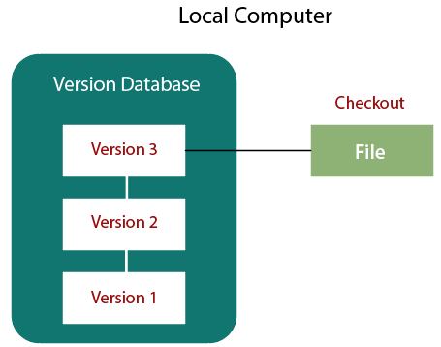
Types of Version Control System
The localized version control method is a common approach because of its simplicity. But this approach leads to a higher chance of error. In this approach, you may forget which directory you're in and accidentally write to the wrong file or copy over files you don't want to.
To deal with this issue, programmers developed local VCSs that had a simple database. Such databases kept all the changes to files under revision control. A local version control system keeps local copies of the files.
The major drawback of Local VCS is that it has a single point of failure.

Slide 7
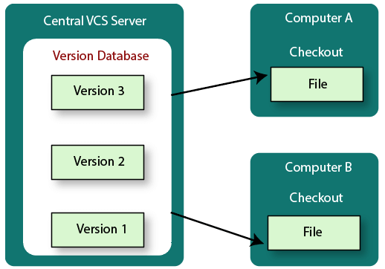
Centralized Version Control System

Slide 8
Centralized Version Control System
The developers needed to collaborate with other developers on other systems. The localized version control system failed in this case. To deal with this problem, Centralized Version Control Systems were developed.
These systems have a single server that contains the versioned files, and some clients to check out files from a central place.
Centralized version control systems have many benefits, especially over local VCSs.
Everyone on the system has information about the work what others are doing on the project.
Administrators have control over other developers.
It is easier to deal with a centralized version control system than a localized version control system.
A local version control system facilitates with a server software component which stores and manages the different versions of the files.
It also has the same drawback as in local version control system that it also has a single point of failure.

Slide 9
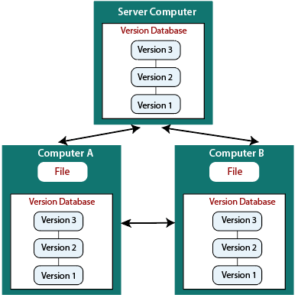
Distributed Version Control System
Centralized Version Control System uses a central server to store all the database and team collaboration. But due to single point failure, which means the failure of the central server, developers do not prefer it. Next, the Distributed Version Control System is developed.
In a Distributed Version Control System (such as Git, Mercurial, Bazaar or Darcs), the user has a local copy of a repository. So, the clients don't just check out the latest snapshot of the files even they can fully mirror the repository. The local repository contains all the files and metadata present in the main repository.
DVCS allows automatic management branching and merging. It speeds up of most operations except pushing and pulling. DVCS enhances the ability to work offline and does not rely on a single location for backups. If any server stops and other systems were collaborating via it, then any of the client repositories could be restored by that server. Every checkout is a full backup of all the data.
These systems do not necessarily depend on a central server to store all the versions of a project file.

Slide 10
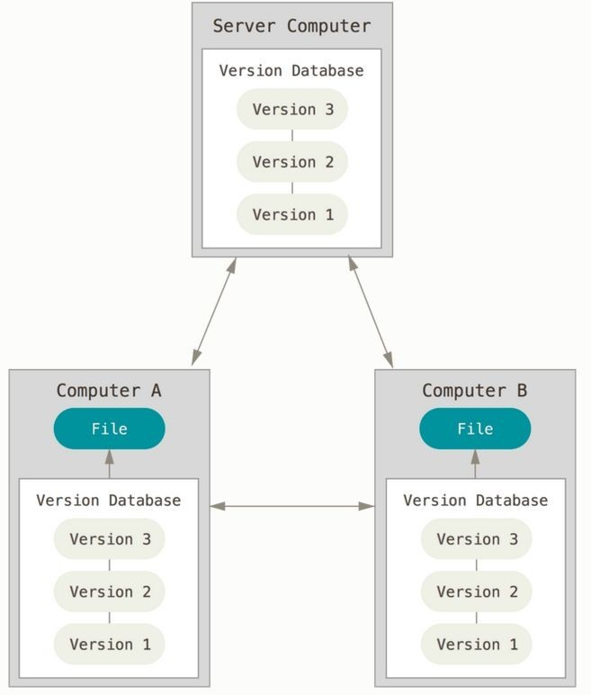
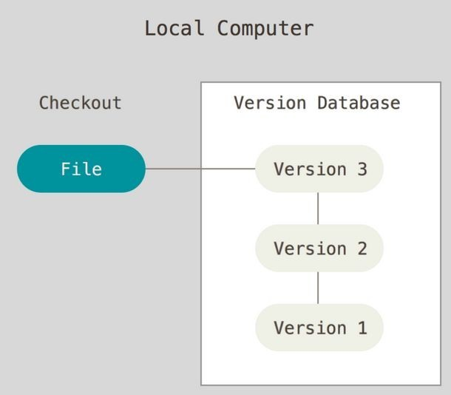
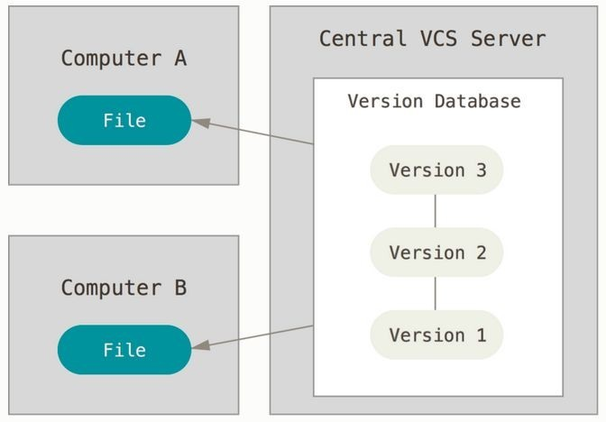
Version Control - W hat and W hy ?
Any kind of practice that tracks and provides control over changes to software code or document.
Local
Centralized
Distributed

Slide 11

Source Code Management ( SCM)
Why SCM ?
SCM is needed when multiple contributor are working on same code base . It server the purposeto:
Allows multiple developer work on same code for different feature .
Undo changes
Alleviates loads of communication betweendeveloper
Flags conﬂicting changes

Slide 12
Version Control - Why ?
Backup and Restore. Files are saved as they are edited. Wrong update can be reverted back
Synchronization. Share ﬁle with developers and end user while continue to develop code
Short-term undo. My build was working before , revert back to working ﬁle and
compare the diff
Long-term undo. Nightly builds are failing . Switch back to last working version and see what change was made that day.
Track Changes.As ﬁles are committed with comments , This makes it easy to see how a ﬁle is evolving overtime, and why.
Track Ownership. Every commit is stored with personname
Sandbox : Make micro development test changes in an controlled area and when
happy commit your changes
Branching and merging. clone the code locally into a separate area and modify it in controlled environemnt and later, merge back into the main code base.

Slide 13

Git - SCM
What is Git
Git is a distributed version-control system for tracking changes in source code during software development. It is designed for coordinating work among programmers, but it can be used to track changes in any set of ﬁles. Its goals include speed, data integrity, and support for distributed, non-linear workﬂows.

Slide 14
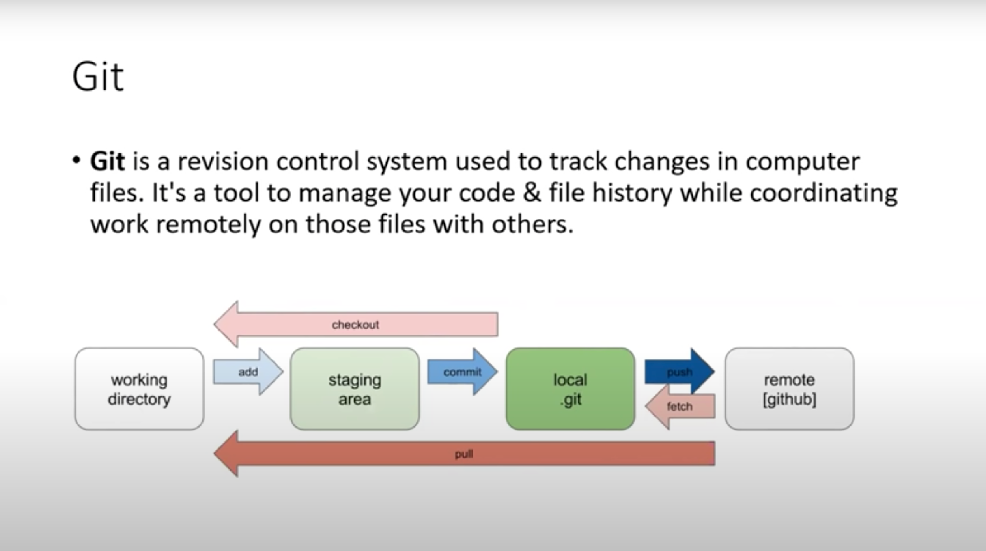

Slide 15
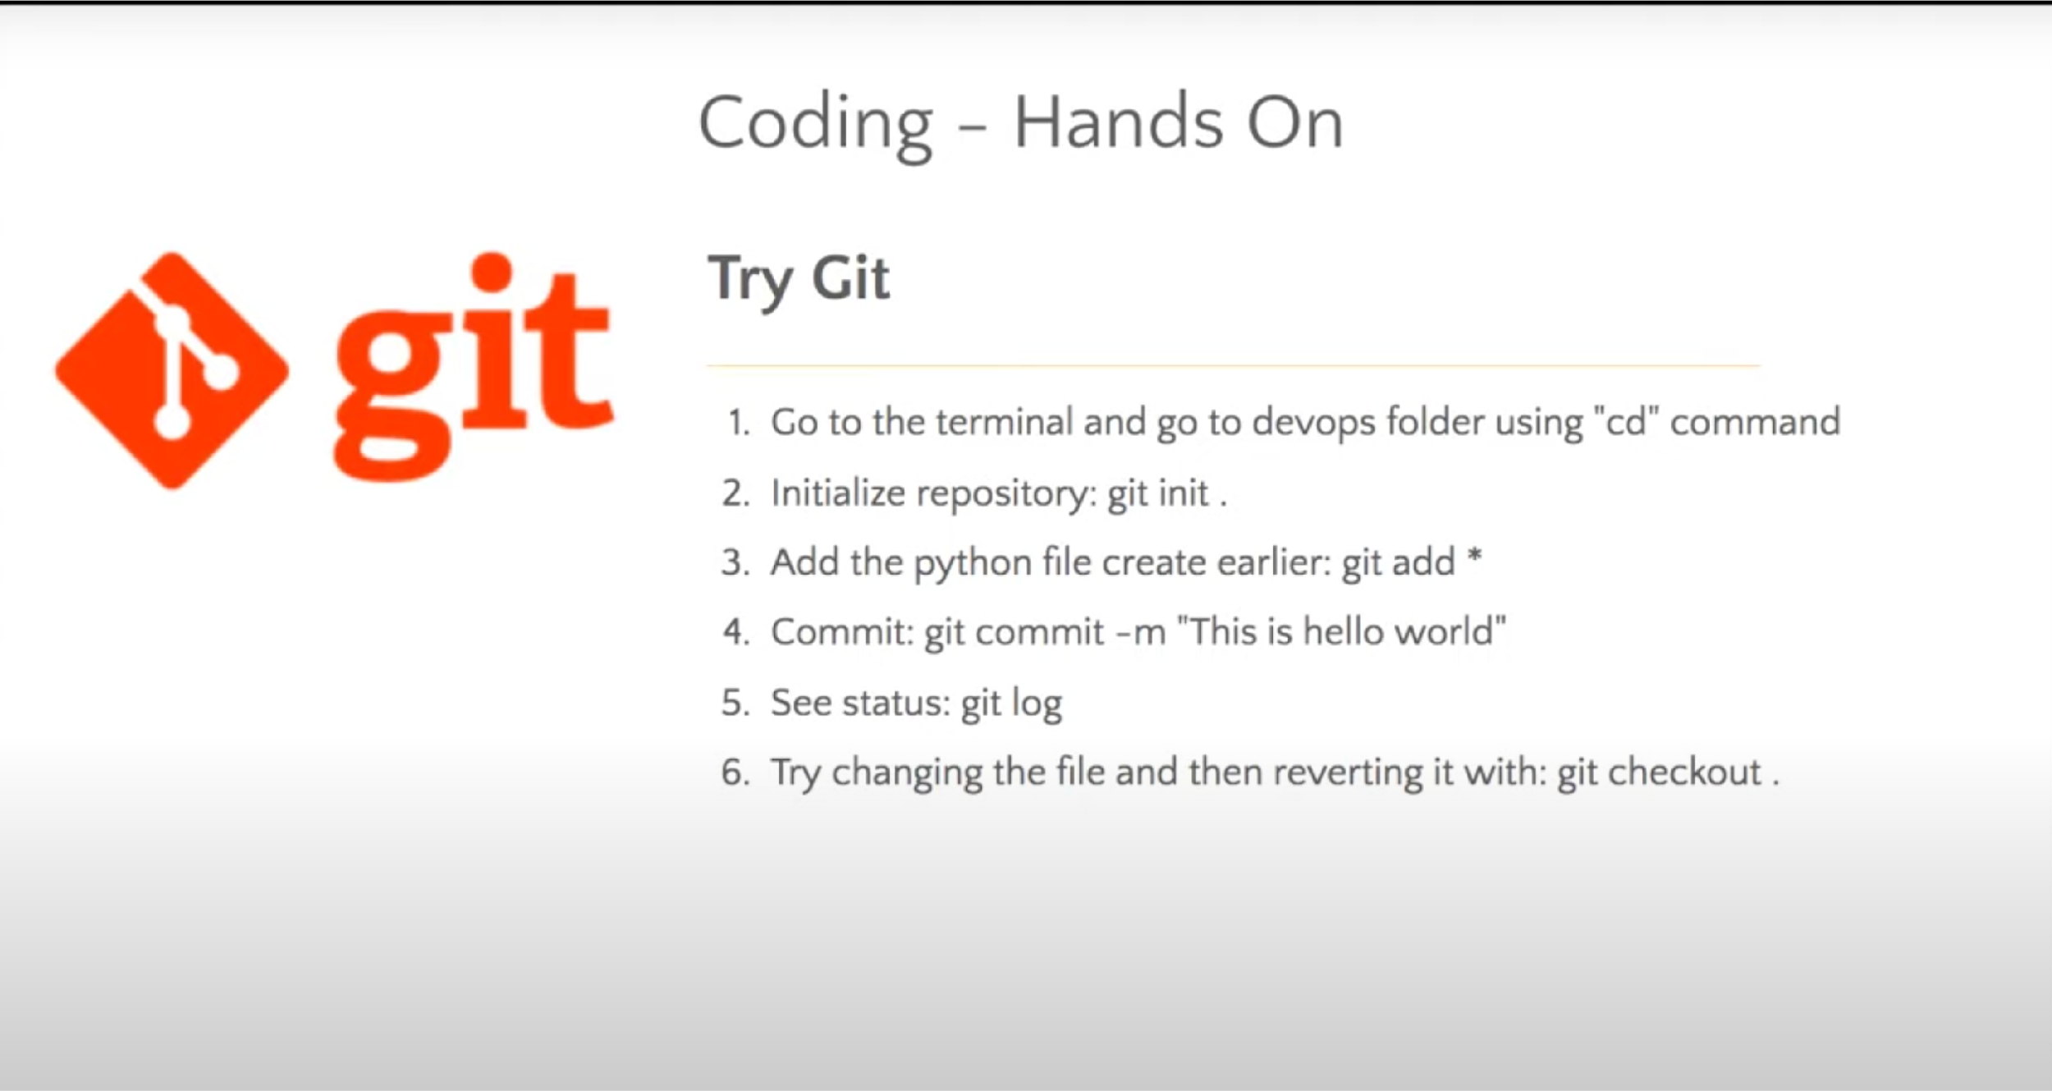

Slide 16
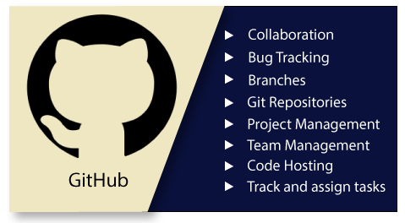
What is GitHub?
GitHub is a Git repository hosting service. GitHub also facilitates with many of its features, such as access control and collaboration. It provides a Web-based graphical interface.
It offers both distributed version control and source code management (SCM) functionality of Git. It also facilitates with some collaboration features such as bug tracking, feature requests, task management for every project.

Slide 17
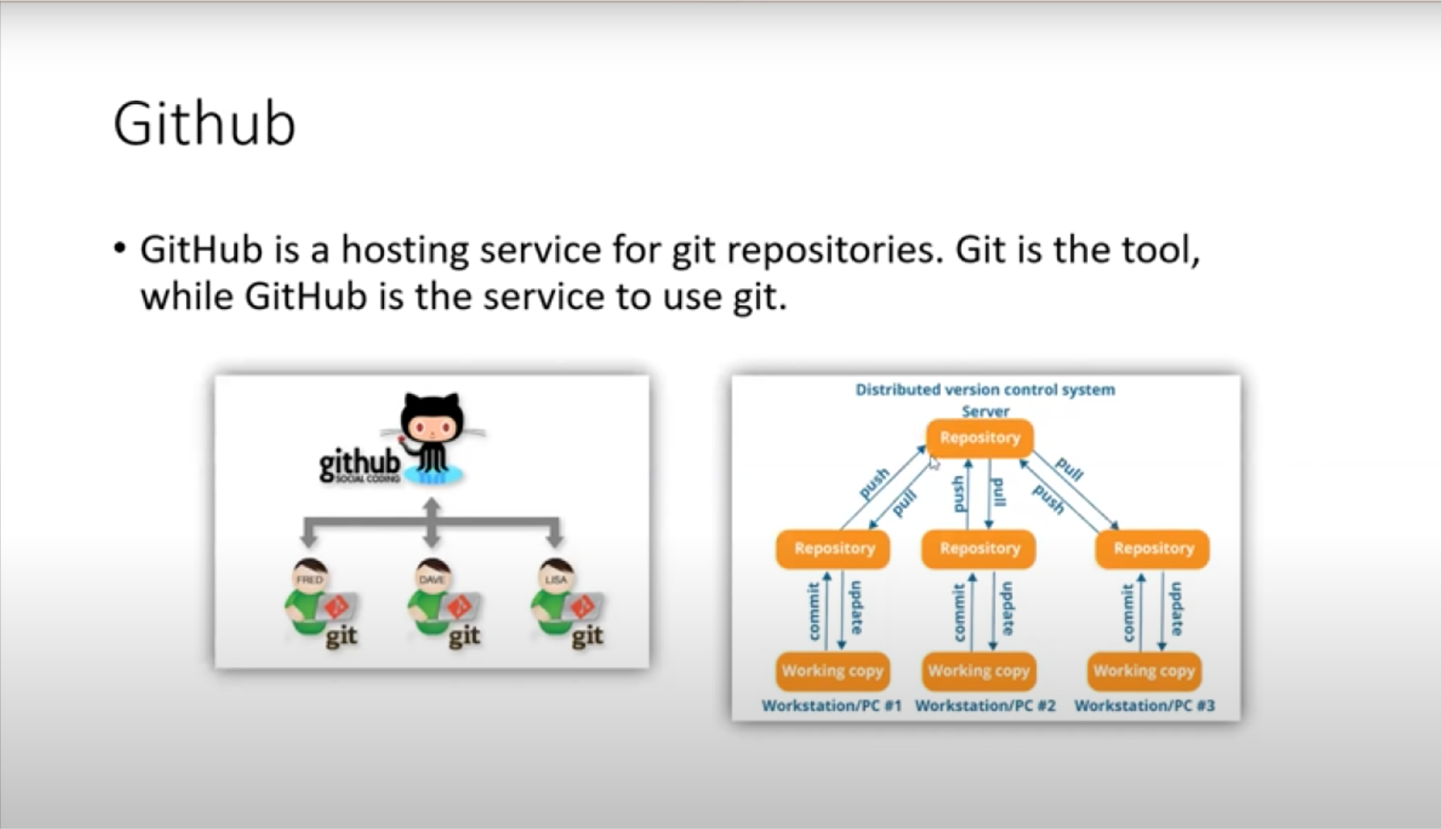

Slide 18
Benefits of GitHub
GitHub can be separated as the Git and the Hub. GitHub service includes access controls as well as collaboration features like task management, repository hosting, and team management.
The key benefits of GitHub are as follows.
It is easy to contribute to open source projects via GitHub.
It helps to create an excellent document.
You can attract recruiter by showing off your work. If you have a profile on GitHub, you will have a higher chance of being recruited.
It allows your work to get out there in front of the public.
You can track changes in your code across versions.

Slide 19
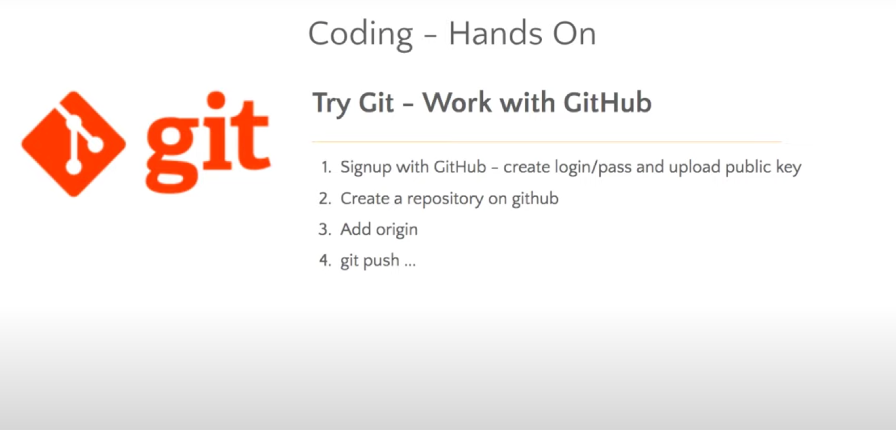

Slide 20
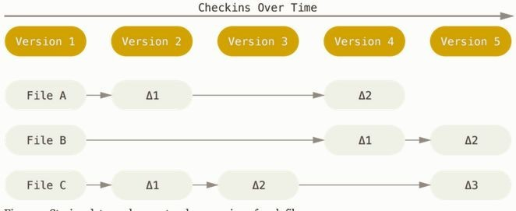
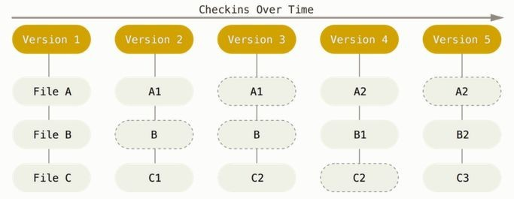
Git - SCM - Why it is different
Git thinks of its data more like a series of snapshots of a miniature ﬁlesystem. With Git, every time you commit, or save the state of your project, Git basically takes a picture of what all your ﬁles look like at that moment and stores a reference to that snapshot. To be efﬁcient, if ﬁles have not changed, Git doesn’t store the ﬁle again, just a link to the previous identical ﬁle it has already stored. Git thinks about its data more like a stream of snapshots.

Slide 21



Git - History
Until 2002, Changes to Linux kernel were passed around as patches and archived ﬁles
In 2002, Linux kernel project started using proprietary version control BitKeeper
In 2005, the relationship between Linux community and BitKeeper broke
!

Slide 22
Git - History
Design goals of Git
Speed
Support for non-linear development - Thousands of parallel branches
Fully distributed
Ability to handle large project like Linux Kernel efﬁciently
In 2005, Linus Torvalds, the creator of Linux, developed Git

Slide 23

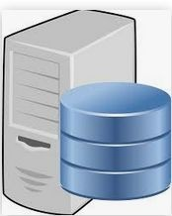


Version Control Centralized
All changes must be pushed to central server
Challenges
Speed
Ofﬂine Access

Slide 24

Version Control -Distributed
Push / Pull
Local Commits
Advantages
Fast
Distributed
Data Integrity
Staging area
Open Source and free
Distributed

Slide 25

Version Control
What is Version Control
Manages changes to a set of ﬁles over time. It also does
Backup
Maintains History about changes
Compare Codes
Experiment
Collaborate

Slide 26

Lab 1- Installing Git
Task 1- Installing locally - Download the git from below link https://git-scm.com/downloads
Run the command git version ( to conﬁrm that installation is successful) sample output : git version 2.20.0
Task 2 - Sign up in GitHub / GitLab / BitBucket for GitUI
Setup up ssh access from command line . Generate ssh key and register with ssh-agent
Run the command to test ssh is setup correctly
git clone git@github.com:singh-ashok25/webserver.git
On successful completion of lab you have
Git installed on host machine
Login access to GitHub or BitBucket ( we will use GitHub in current exercise)

Slide 27
Generating ssh keys on windows
Using Gitbash window
ssh-keygen - t rsa - b 4096 # will generate ssh key
it is advisable to generate aleasy 4096 bit key
Using Puttygen
Launch Puttygen , Click on Generate key and move mouse point in white area.
Save private and public in safe location
Copy content of ﬁle .ssh/id_rsa.pub to ssh key page of GitHub
Run git clone command test the key

Slide 28
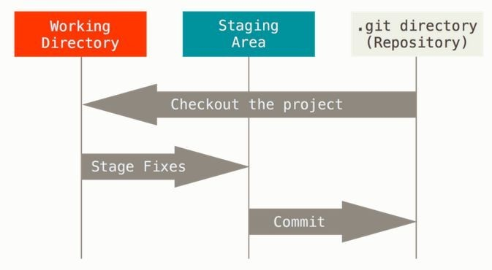

Advantages of Git
Git beneﬁts
-Create new ﬁles
-Update ﬁles
-Remove ﬁle
Save ﬁle into history
Add File to project
Performance
Security
Flexibility
Functionality
Working Area
Staging Area

Slide 29
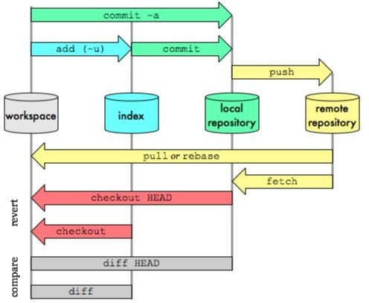
Working with Git - DataFlow

Slide 30



Working with Git - Setup Environment
Git can be integrated with range of IDE like eclipse, pyCharm , VScode
Git can also conﬁgured in shell showcurrent repo
ashoksingh@Ashoks-Air ~/Devops-Course/GIT/LAB1/webserver (master) $ git checkout feature/add-new-page Switched to branch'feature/add-new-page'
ashoksingh@Ashoks-Air ~/Devops-Course/GIT/LAB1/webserver (feature/add-new-page)
ashoksingh@Ashoks-Air ~/Devops-Course/GIT/LAB1/webserver (feature/add-new-page)* $
Below code will set the shell prompt environment .
parse_git_branch() {
git branch 2> /dev/null | sed -e '/^[^*]/d' -e 's/* \(.*\)/ (\1)/'
}
parse_git_dirty() {
[[ -n "$(git status -s 2> /dev/null)" ]] && echo "*"
}
export PS1="\u@\h \[\033[32m\]\w\[\033[33m\]\$(parse_git_branch)\$(parse_git_dirty)\[\033[00m\] $ "

Slide 31
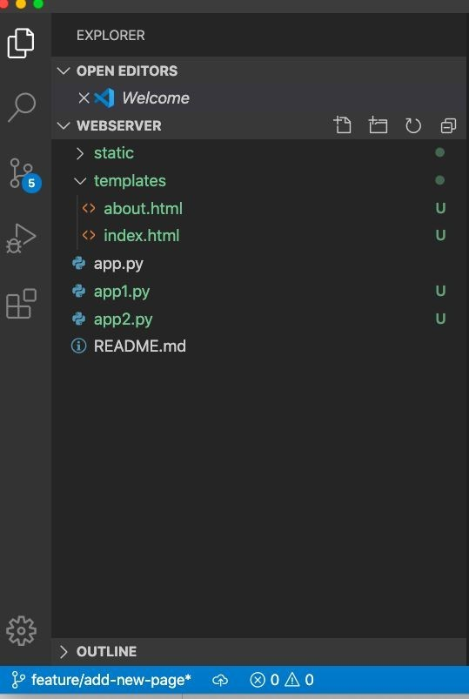
Working with Git - Setup VSCode Environment
VSCode is a free IDE which good features
Install support for python language
Shows Untracked ﬁle in Git Repo.(U)
Working GIt branch is displayed
* Dirty branch status is shown
Files can be added by clicking + sign which run git
add command in background

Slide 32
Git Fundamental
Working with Git

Slide 33
Working with Git - Setting up Repository
What is a Git repository?
A Git repository is set of ﬁles which are needed for a project. It allows you to save versions of
your code, which you can access when needed.
git init can be used to convert an existing, unversioned project to a Git repository orinitialize a new, empty repository. Most other Git commands are not available outside of an initialized repository, so this
is the ﬁrst command to be run
The git init command creates a new Git repository.
cd <code-directory>
git init
git remote add origin git@github.com:<username>/<repo-name>.git
git push -u origin master

Slide 34
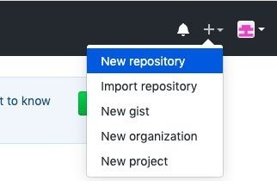
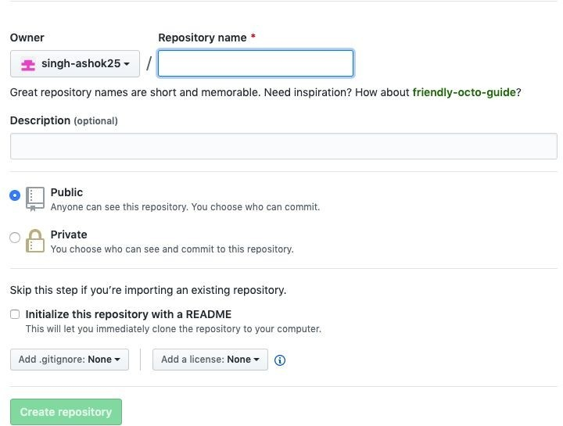
Lab 2 - Creating repository
Objective : Creating a repository for a sample project code base in Git. Setting up development environment for IDE
Task 1: Create New repo on Github.Do not initialize the new repository with README, license, or gitignore ﬁles. You can add these ﬁles after your project has been pushed to GitHub.
STEP 1
STEP 2

Slide 35
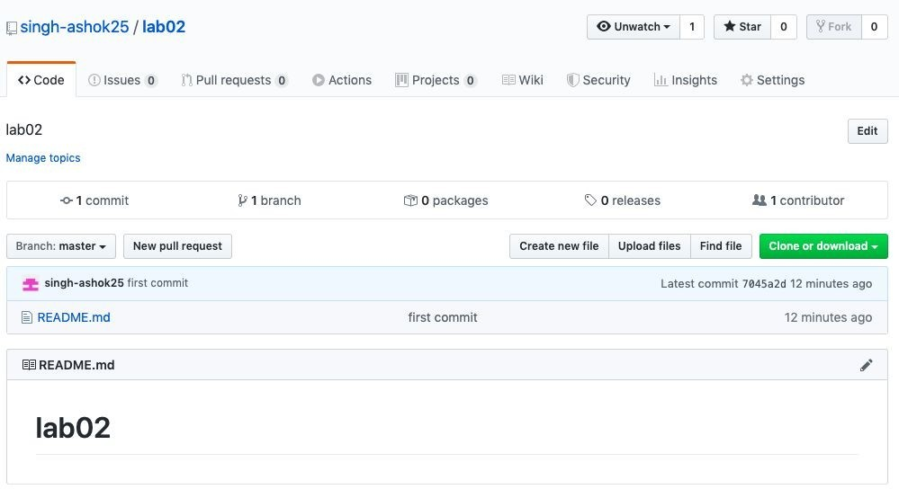
Lab 2 - Creating repository
TASK - 2 - Run below commands
echo "# lab02" >>README.md
git init
git add README.md
git commit - m "ﬁrst commit"
git remote add origin git@github.com:<user_name>/<repo_name>.git
git push -u originmaster
On successful completion of lab you have
Git repository created for your project
IDE or shell prompt displaying git status

Slide 36
Working with Git - Setting up Repository
Git Conﬁg levels and ﬁles
local
By default, git conﬁg will write to a local level if no conﬁguration option is passed
global
Global level conﬁguration is applied to an operating system user. Global conﬁguration values
are stored in a ﬁle that is located in a user's home directory.
git config --global user.email "your_email@example.com" git config --global user.name "<github username>”
system
System-level conﬁguration is applied across an entire machine. This covers all users on
an operating system and all repos. .

Slide 38
Working with Git - Cloning a repository
Git Clone : Git command line utility create a exact copy of repository on local host. Git clone allows quick development collaboration
Clone git repository
git clone <repo>
Cloning to a speciﬁc folder
git clone <repo> <directory>
Cloning a speciﬁc tag
git clone --branch <branch_name> <repo>
Shallow clone
git clone --depth=1 <repo>

Slide 39
Lab 3 -Using a public repository for local development
Objective : Use available code base in the public repository for you task customise it for indivudual need.
Task 2- Login to GitHub and clone any public repository .
for the purpose of lab we will be forking using GitHub
Repo https://github.com/singh-ashok25/webserver
Install Python3 & Install Flask ( https://www.python.org/downloads/)
git clone <repo>
python3 app.py
On successful completion of lab you have
Working webserver with message “ Welcome to Lab - Flask Website

Slide 40
Working with Git - Working Area
Add new ﬁle/ﬁles inrepository
git add <new-filename/new-directory>
Updating ﬁle/ﬁles in repository
git commit -m “<comment>” <filename>
Deleting ﬁle/ﬁles in repository
git -rm -f <filename>
Local Commits

Slide 41
Working with Git - Status
Git Status : Status displays the state of the working and staging area.Status command output includes relevant instructions for staging/unstaging ﬁles. Generally there are 3 categories of status
Changes to be committed:
Changes not staged for commit:
Untracked ﬁles:
On branch feature/ashok-page Changes to be committed:
(use "git reset HEAD <file>..." to unstage)
new file: newfile
Changes not staged for commit:
(use "git add <file>..." to update what will be committed)
(use "git checkout -- <file>..." to discard changes in working directory)
modified: README.md
Untracked files:
(use "git add <file>..." to include in what will be committed)
newfile2

Slide 42
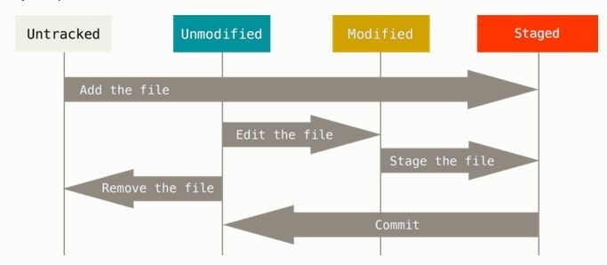
Git File Status

Slide 43
Working with Git - Tagging
Git Tag: Tags are used to bookmark commits. there are 2 types of tag. Tagging are used extensively for Release management process . Tag also helps for development reporting
Annotated tags :Annoted tag store metadata about the tag like the commit objects
git tag -a v1.4 -m “Comments”
Lightweight tag :Lightweight tags create a new tag checksum and store it in the .git/ directory of the project's repo.
git tag v1.4-lw
Listing Tags and deleting Tas
git tag
git tag -d <tag name>
Pushing Tags :Sharing tags is similar to pushing branches. By default, git push will not push tags. Tags have to be explicitly passed to git push.
git push origin v1.4

Slide 44
Working with Git - Undoing Commits
Git checkout :
Switch branches or restore working tree ﬁles.it also updates ﬁles in the working tree to match the
version in the index or the speciﬁed tree.
git checkout <branch-name>
Git clean
Cleans the working tree by recursively removing ﬁles that are not under version control, starting from the current directory..
git clean -i
git logs
ch
git log --graph --pretty=format:'%Cred%h%Creset -%C(yellow)%d%Creset %s
%Cgreen(%cr) %C(bold blue)<%an>%Creset' --abbrev-commit

Slide 45
Working with Git - Reset and remove
Git reset
Reset current HEAD to the speciﬁed state. mixed reset is the default option. The three arguments
each correspond to Git's three internal state management mechanism, The Commit Tree (HEAD), The Staging Index, and The Working Directory.
git reset soft|mixed|hard HEAD~
Git rm
Remove ﬁles matching pathspec from the index, or from the working tree and the index. git rm will not remove a ﬁle from just your working directory.
git rm <file-name>

Slide 46
Collaborating with Git - Syncing
Git fetch : The git fetch command downloads commits, ﬁles, and refs from a remote repository intoyour local repo.Fetching is what you do when you want to see what everybody else has been working on.
git fetch [<branch-name>]
Git pull : The git pull command is used to fetch and download content from a remote repository and immediately update the local repository to match that content. The git pull command is actually a combination of two other commands, git fetch followed by git merge.
git pull
Git push :The git push command is used to upload local repository content to a remote repository. Pushing is how you transfer commits from your local repository to a remote repo. It's the counterpart to
git fetch, but whereas fetching imports commits to local branches, pushing exports commits to remote branches.
git push

Slide 47
Git Branching
Collaborating with Git

Slide 48
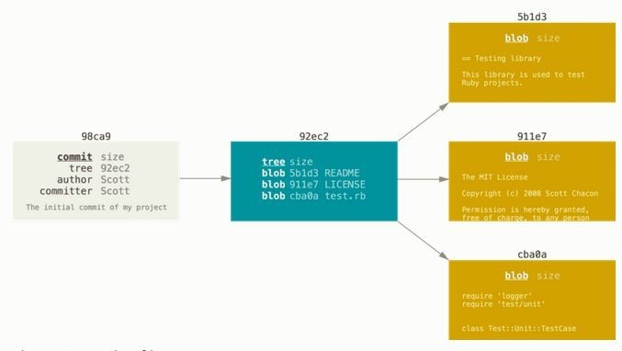

Git - Branching in a nutshell
README
test.rb
LICENSE
git add READMEtest.rb
LICENSE
git commit - m 'Initial commit'
3 ﬂies and one tree that lists the contents of the directory and speciﬁes which ﬁle names are stored as which blobs, and one commit with the pointer to that root tree and all the commit metadata

Slide 49

Git - Branching and Merging - Sample Workﬂow
Master branch is maintains the most stable code base
Create a new branch (for new feature , story or bug)
Update -add , commit and pushchanges
Add new ﬁle to repos
Commit changes to local repo
push changes to server
Create Pull Request
Request changes to be merged to master branch
Review your code
Resolve conﬂict
Why with conﬂict happen ?
Merge to Master
Master branch
Create a new branch
Update -add , commit andpush changes
Create Pull Request
Resolve conﬂict
Merge to Master

Slide 50
Working with Git - Create Feature Branch
Create branch
git branch “<branch-name>”
Start working on the branch - checkout
git checkout feature/<name.-page
Switched to branch 'feature/<name>-page'

Slide 51
Lab 4 - Developing feature to a public repository
Objective : Developing feature in a public repository to solve a problem or add functionality
Task
Create a feature branch name is “feature/<name>”
Switch to above branch
Edit index.html ﬁle in templates directory to add blue line . Relace it <your_name> with
your name
<ahref="{{ url_for('about') }}">About Us</a>
</br> <aherf=“"{{ url_for('<your_name>') }}"><your_name></a>
cp about.html <your_name>.html ( you can customised your_name.html ﬁle )
update app2.py ﬁle as below
@app.route("/<your_name>.html") def <your_name>():
return render_template('<your_name>.html')

Slide 52
Lab 4 - Developing feature to a public repository
On successful completion of lab you will have:
Added a new link of your_name on main home page of web server.

Slide 53
Git Collaboration
Collaborating with Git

Slide 54
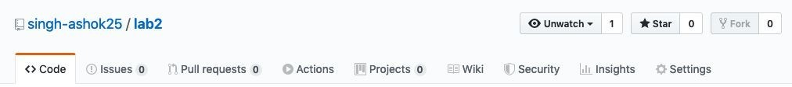
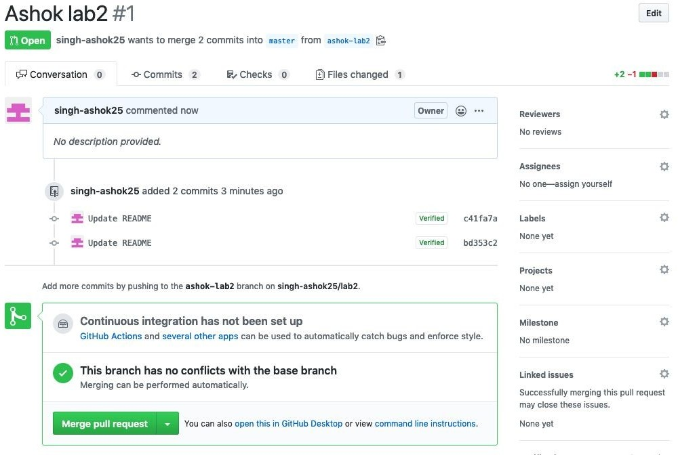
Collaborating with Git - Making a Pull Request
Login to GitHub
Click on Pull Request

Slide 55
Lab 5 - Submitting feature to a public repository
Objective : Push local code changes to feature branch in public repository
Task :
Push local repo change of new feature to server repo
login to GitHub and create a PullRequest
Once Pull Request is merged by repo owner . you changes will be publicly released.
validate yourchanges are Merged in main branch
Congratulations!! - you have contributed into a public repo

Slide 56
Git Workﬂow
Feature / Release developmentprocess

Slide 57

Git Feature Branch Workﬂow
The core idea behind the Feature Branch Workﬂow is that all feature development should take place in a dedicated branch instead of the master branch.
1branch per feature
one developer can be working on multiple branch at same time
all feature merge in master after conﬂict resolution

Slide 58
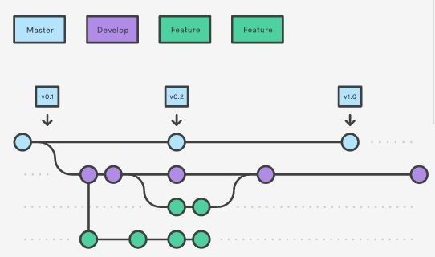
GitFlow Workﬂow

Slide 59
Forking Workﬂow
A developer 'forks' an 'ofﬁcial' server-side repository. This creates their own server-side copy.
The new server-side copy is cloned to their local system.
A Git remote path for the 'ofﬁcial' repository is added to the local clone.
A newlocal feature branch is created.
The developer makes changes on the new branch.
New commits are created for the changes.
The branch gets pushed to the developer's own server-side copy.
The developer opens a pull request from the new branch to the 'ofﬁcial' repository.
The pull request gets approved for merge and is merged into the original server-side repository

Slide 60
Git - Best practises
Squash rebase workﬂow for Git Commits
Feature branch should be squashed down to a single buildable commit, and then rebased from the up-to-date main branch.
git pull origin master
git checkout - b branchName
git log --graph--decorate --pretty=oneline --abbrev-commit
git rebase -i
git push origin branchName --force

Slide 61
Thank you

Slide 62
Git - squashing commits and rebase
Create a feature branch with 4 commit and push it repo.(feature A branch)
git rebase -i ( interactive)
squash commits
exit the editor and update the combined commit

